Slide 1
Immigrant Access to Health Coverage Under the ACA, Medicaid & CHIP…
…and how to Build enrollment under the Restored federal “Public Charge” Rule, and during Medicaid “unwinding”
Webinar 10/06/2023; slides 34-X revised 10/26/22
Anne Dunkelberg, Senior Fellow, Every Texan
dunkelberg@everytexan.org

Slide 2
Agenda
Topics:*
Immigrant Eligibility under Medicaid, CHIP and the ACA
Pregnant Immigrant Eligibility
Enrollment Barriers for Immigrants in the Marketplace
Fear of Applying for and Using Benefits
NEW Public Charge Rule
How recent policies before the new rule harmed health care and food aid access.
(* Family Glitch news)

Slide 3
Immigrant Eligibility
Under the ACA most lawfully present immigrants are eligible for some type of affordable coverage

Slide 4
Preview: Texas Medicaid, CHIP, Marketplace and Immigrants
Texas covers under-age-19 “lawfully present” immigrant kids and youth in Medicaid and CHIP
But does NOT cover most 19-and-older “qualified immigrants” in Medicaid, including not covering pregnant women. (One of only 7 states that do not cover adult “qualified immigrants”)
“Medicaid Exception” required in federal law: if have 40 quarters work history, or active duty military- treat like US citizen.
Undocumented residents at any age are excluded from Medicaid, CHIP and ACA Marketplace (not even full-cost purchase)
The ACA requires that if “lawfully present” immigrants are excluded from Medicaid because of their non-citizen status, then they CAN get Marketplace subsidies (APTCs and CSRs) -- even with incomes at or below the poverty line (more, next slide).
Texas’ unusual immigrant Medicaid policies result in some complex eligibility situations.

Slide 5
Special Marketplace PTC Rule
The PTC income floor of 100% FPL does not apply to non-citizens who have a “lawfully residing/present” status, but are not eligible for Medicaid due to their immigration status (part of federal ACA law).
• This includes people who have a lawfully residing/present status who:
Do not have a “qualified” immigration status (i.e., “lawfully present” list is more inclusive)
Have a "qualified" immigration status who are subject to and have not met the 5-year bar
More on “qualified” and “lawfully present” in a minute….)
• Bottom line: In Texas, many people who have a lawfully residing/present status and incomes in the Medicaid range or below 100% FPL are eligible for PTC and CSR

Slide 6
Help Paying for Coverage Under the ACA, non-citizens
400% FPL
$120,000/yr
Just APTCs
Just APTCs
Just APTCs
250% FPL
$75,000/yr
Family Income
APTCs and CSRs
206% FPL
$61,800/yr
APTCs and CSRs
CHIP
The ACA did not address access to health coverage for undocumented immigrants.
Individuals with DACA status are still not eligible to purchase insurance (pending fed rule could change in future)
138% FPL
$41,400/yr
Medicaid
APTCs and CSRs
100% FPL $30,000/yr
Coverage Gap
Medicaid for Parents
Children
U.S. Citizen & “Medicaid Exception” Immigrants
MOST Lawfully Present Adults
(Not Medicaid Eligible)
Note: Income amount based on 2023 FPL levels for a family of four
Notes:
Under the ACA all U.S. citizens and lawfully present immigrants under 400 percent of the federal poverty line should have access to help paying for insurance.
However, the Supreme Court made the expansion of Medicaid to adults up to 138 percent of poverty optional.
Texas elected leaders have opposed the ACA in general and have refused to create coverage for the uninsured Texans in this income group.

Slide 7
“Lawfully Present” Immigration Categories Eligible for Marketplace Coverage – Part 1
ALL “qualified” non-citizens
PLUS Other “Lawfully Present” Immigrants:
“Qualified” Immigrants:
Lawful Permanent Resident (LPR/green card holder)
Refugee
Asylee
Cuban/Haitian Entrant
Paroled into the U.S. for at least one year
Conditional Entrant
Granted Withholding of Deportation or Withholding of Removal
Battered Spouse, Child and Parent
Trafficking Survivor and his/her Spouse, Child, Sibling or Parent (“T visa”)
individuals residing in the U.S. pursuant to a Compact of Free Association (COFA)* (for Medicaid purposes only)
Others:
Member of a federally-recognized Indian tribe or American Indian born in Canada
Granted relief under the Convention Against Torture (CAT)
Temporary Protected Status (TPS)
Deferred Enforced Departure (DED)
Deferred Action (except DACA)
Paroled into the US for less than one year
Individual with Nonimmigrant Status (includes worker visas; student visas; U visas; and many others)
Administrative order staying removal issued by the Department of Homeland Security
Lawful Temporary Resident
Family Unity
* Citizens of the Marshall Islands, Micronesia, and Palau who are living in one of the U.S. states or territories

Slide 8
“Lawfully Present” Immigration Categories Eligible for Marketplace Coverage – Part 2
APPLICANT for Any of These Statuses:
Must Also Have Employment Authorization:
Lawful Permanent Resident (with an approved visa petition)
Special Immigrant Juvenile Status
Victim of Trafficking Visa (T visa)
Withholding of deportation or withholding of removal, under the immigration laws or under the Convention Against Torture (CAT)*
Applicant for Temporary Protected Status
Registry Applicants
Order of Supervision
Applicant for Cancellation of Removal or Suspension of Deportation
Applicant for Legalization under IRCA
Applicant for LPR under the LIFE Act
Applicants for asylum*
*Only those who have been granted employment authorization or are under the age of 14 and have had an application pending for at least 180 days are eligible

Slide 9
If new rule takes effect after OE ends, DACA folks will be able to use SEP to enroll.
BTB project has slides that shows how QI and LP charts will change if rule takes effect.

Slide 10
Texas has chosen to provide Medicaid and CHIP to all lawfully present children.
Still, lawfully present children are sometimes incorrectly denied Medicaid/CHIP based on immigration status by HHSC.
Certain lawfully present children are not eligible for an SSN. Still, Texas HHSC has also incorrectly denied some of these children due to failure to provide an SSN.
Frequent problems this year:
children with F-2 and T visas
Denial notices based on lack of SSN, despite status that doesn’t allow SSN, or where a SSN application is already pending
Every Texan can provide assistance if you believe a non-citizen child has been incorrectly denied Medicaid or CHIP.
Notes:
Start with Welfare reform act (include five year bar and qualified immigrant) then moved forward to CHIPRA and ACA.
CHIPRA provides state option to cover “Lawfully Present” children and pregnant women; ACA adopted same “lawfully present” definition for Marketplace. In 2009, the Children’s Health Insurance Program Reauthorization Act (CHIPRA) was signed into federal law. CHIPRA expanded the categories of immigrants who may gain access to Medicaid and CHIP, at state option: “lawfully present” residents of a state. CHIPRA gave states the option to cover children and pregnant women in Medicaid and CHIP without the five-year bar imposed in 1996.
Soon afterward, the ACA was signed into law, and used the same lawfully present grouping to define the immigrants eligible for participation and affordability help in the 2014 health insurance Marketplaces. 20
The lawfully present grouping is, as the name suggests, broader than the 1996 qualified immigrant grouping. Virtually all immigrants with a legal status are included in the CHIPRA state options for lawfully present pregnant women and children, assuming they can also meet other program requirements like income and residency.

Slide 11
Common HHSC Errors in Lawfully Present Immigrant Medicaid and CHIP applications
On a Children’s Medicaid application or renewal, a request for information for citizenship and sponsor information for a non-citizen parent, when only the children were applying/renewing.
When applying for coverage for children, parents immigration status and sponsorship are not relevant or required (states can’t add different requirements)
US citizen children are not subject to sponsorship, only the lawfully present parent
Lawfully present children are exempt from sponsor deeming and liability under federal law
Denial for a Children’s Medicaid app/renewal for failure to provide SSN.
A number of lawfully present immigration statuses do not provide SSN for the immigrant, but they are Medicaid eligible (e.g., F2 visa, TN NAFTA visa holder and TD).
SSN should not be required at renewal unless something has changed
Unwinding errors
Multiple conflicting notices: one says denied, another says month-to-month
Spanish speaker receiving information about their case in English when they have requested Spanish as their preferred language from HHSC
Siblings split between Medicaid and CHIP despite identical HH

Slide 12
Adult “Qualified Immigrants” who might Qualify for Medicaid – Texas rules
These folks must have met 5-year bar AND have 40 qualifying quarters of U.S. work
For these, Five-year bar/40 quarters NOT required, treated like U.S. citizen
Lawful Permanent Resident (LPR/Green Card holder)
Paroled into the U.S for 1 year or more
Battered spouse, child, or parent who has a pending or approved petition with DHS
Applicants for Victim of Trafficking
Conditional Entrant (granted before 1980)
People who physically entered the U.S. before 8/22/96 and remained in the U.S. continuously until obtaining a qualified status
Lawful Permanent Residents who adjusted from a status exempt from the 5-year bar (e.g., refugee, asylee)
Veterans or active duty military, and their spouses or unmarried dependents who also have “qualified non-citizen” status
Refugee
Asylee
Cuban/Haitian Entrants
Granted Withholding of Deportation or Withholding of Removal Visa
Trafficking Survivors and their spouses, children, siblings, or parents
Member of a federally recognized Indian tribe or American Indian born in Canada
Amerasian Immigrants
Iraqi and Afghani Special Immigrants; or people from Ukraine who are granted “parole” into the U.S.
NOTE: Even if your client has an immigration status that makes them potentially eligible for Medicaid, without Medicaid expansion most adults will fall into the Medicaid Coverage Gap unless they are pregnant or are a very low-income parent. Many will qualify for Marketplace Help.

Slide 13
Which group is your client in?
Non-citizen adult who is treated like U.S. citizen in policy?
(Certain humanitarian status, LPR w/ 40 QQ, Veterans/Active Duty)
Lawfully Present adult but NOT in a special group treated like a citizen by policy?
Undocumented or DACA-mented?
Lawfully Present
child?

Slide 14
Scenario #1
Yasmin, Aaden, and their two children live in San Antonio.
Aaden is an LPR.
Yasmin and the two children have approved visas and have applied to adjust their status to LPR.
Combined Aaden and Yasmin do not yet have 40 quarters of work.
Their family income is at 85% of the FPL (<$23,600 in 2022)
What are their coverage options?
Notes:
Mom and Dad – Medicaid Gap (Refugee Medical Assistance for first 8 months)
Kids - Medicaid

Slide 15
400% FPL
$111,000/yr
Answer:
Kids can get Medicaid
Mom and Dad are eligible for Marketplace coverage.
Just APTCs
Just APTCs
Just APTCs
250% FPL
$69,375/yr
Family Income
APTCs and CSRs
206% FPL
$57,165/yr
APTCs and CSRs
CHIP
APTCs and CSRs
138% FPL
$38,295/yr
Medicaid
100% FPL $27,750/yr
Kid
Kid
Coverage Gap
Dad
Mom
Kid
Kid
Dad
Mom
Medicaid for Parents
Children
U.S. Citizen & “Medicaid Exception” Immigrants
Lawfully Present Adults
(Not Medicaid Eligible)
Note: Income amount based on 2022 FPL levels for a family of four.
Notes:
Under the ACA all U.S. citizens and lawfully present immigrants under 400 percent of the federal poverty line should have access to help paying for insurance.
However, the Supreme Court made the expansion of Medicaid to adults up to 138 percent of poverty optional.
Texas elected leaders have opposed the ACA in general and have refused to create coverage for the uninsured Texans in this income group.

Slide 16
Scenario #2
Liz and Joseph are married and have a son named Henry
Liz has Temporary Protected Status (TPS)
Joseph entered the U.S. as a refugee 4 years ago. He gained LPR status last year.
Henry has U.S. citizenship status
No one has an employer offer of coverage.
Their household income is at 95% of the FPL (<$21,900 in 2022).
What are their coverage options?
Notes:
Mom & Dad – Marketplace
Kid - Medicaid

Slide 17
400% FPL
$92,120/yr
Answer:
Son can get Medicaid
Mom is eligible for the Marketplace.
Dad is in the coverage gap.
Just APTCs
Just APTCs
Just APTCs
250% FPL
$57,575/yr
Family Income
APTCs and CSRs
206% FPL
$47,442/yr
APTCs and CSRs
CHIP
138% FPL
$31,781/yr
Medicaid
APTCs and CSRs
100% FPL $23,030/yr
Coverage Gap
Kid
Dad
Mom
Medicaid for Parents
Children
U.S. Citizen & “Medicaid Exception” Immigrants
Lawfully Present Adults
(Not Medicaid Eligible)
Note: Income amount based on 2022 FPL levels for a family of three.
Notes:
Under the ACA all U.S. citizens and lawfully present immigrants under 400 percent of the federal poverty line should have access to help paying for insurance.
However, the Supreme Court made the expansion of Medicaid to adults up to 138 percent of poverty optional.
Texas elected leaders have opposed the ACA in general and have refused to create coverage for the uninsured Texans in this income group.

Slide 18
Scenario #2
Miguel and Carla live in Austin.
Miguel is getting his MBA and has an F-1 student visa.
Carla is a U.S. citizen.
Neither has an employer offer of coverage.
Their family income is 85% of the FPL (<$15,600 in 2022).
What are are their coverage options?
Notes:
Mom & Dad – Marketplace
Kid - Medicaid

Slide 19
400% FPL
$73,240/yr
Answer:
Miguel is eligible for the Marketplace.
Carla is in the coverage gap.
Just APTCs
Just APTCs
Just APTCs
250% FPL
$45,775/yr
Family Income
APTCs and CSRs
206% FPL
$37,719/yr
APTCs and CSRs
CHIP
APTCs and CSRs
138% FPL
$25,268/yr
Medicaid
100% FPL $18,310/yr
Coverage Gap
C
M
Medicaid for Parents
Children
U.S. Citizen & “Medicaid Exception” Immigrants
Lawfully Present Adults
(Not Medicaid Eligible)
Note: Income amount based on 2022 FPL levels for a family of two.
Notes:
Under the ACA all U.S. citizens and lawfully present immigrants under 400 percent of the federal poverty line should have access to help paying for insurance.
However, the Supreme Court made the expansion of Medicaid to adults up to 138 percent of poverty optional.
Texas elected leaders have opposed the ACA in general and have refused to create coverage for the uninsured Texans in this income group.

Slide 20
PTC-Related Rules for Married People Who Have Nonresident Status
To qualify for PTC, an applicant who is married must file jointly with their spouse.
Certain immigrants must file taxes on Form 1040-NR:
Some people who have non-immigrant visas (often college students who have an F, J, M, or Q visa) must file taxes on Form 1040-NR because they can’t meet the “substantial presence test” in their first five years in the US
BUT, Form 1040-NR doesn’t allow most people who are married and have nonresident immigration status to file jointly with a spouse—as a result, they can’t meet the joint filing requirement to claim a PTC.

Slide 21
Scenario #3
Trevor and Linda live in Houston.
He studies at the University and has an F-1 student visa, his wife and children have F-2 visas.
He is not working for the university and has no employer offer of coverage.
He would like to explore other coverage options before purchasing the student plan from the university.
Their family income is 110% of the FPL ($30,525 in 2022).
What are are their coverage options?
Notes:
Mom & Dad – Marketplace
Kid - Medicaid

Slide 22
400% FPL
$111,000/yr
Answer:
Kids are eligible for Medicaid.
Mom and Dad aren’t eligible for Marketplace help because they cannot file a joint tax return.
Just APTCs
Just APTCs
Just APTCs
250% FPL
$69,375/yr
Family Income
APTCs and CSRs
206% FPL
$57,165/yr
APTCs and CSRs
APTCs and CSRs
CHIP
Mom
Dad
138% FPL
$38,295/yr
Medicaid
Kid
Kid
100% FPL $27,750/yr
Coverage Gap
Kid
Kid
Dad
Mom
Medicaid for Parents
Children
U.S. Citizen & “Medicaid Exception” Immigrants
Lawfully Present Adults
(Not Medicaid Eligible)
Note: Income amount based on 2022 FPL levels for a family of four.
22
Notes:
Under the ACA all U.S. citizens and lawfully present immigrants under 400 percent of the federal poverty line should have access to help paying for insurance.
However, the Supreme Court made the expansion of Medicaid to adults up to 138 percent of poverty optional.
Texas elected leaders have opposed the ACA in general and have refused to create coverage for the uninsured Texans in this income group.

Slide 23
Enhanced Federal Subsidies Continue, make coverage more affordable for qualifying immigrants
ARPA 2021: BIG boost in subsidy, now continued through 2025 under Inflation Reduction Act (IRA)
Increased subsidies for people previously eligible with incomes under 400% of the federal poverty level (FPL).These enhanced subsidies, for the first time, allow those with incomes under 150% FPL to get full coverage with a $0/month premium and a low or no deductible.
Ending the “subsidy cliff.” For the first time, people with incomes over 400% FPL (about $54,500/year for an individual and $92,000/year for a family of 3) can get APTC financial assistance. Subsidy-eligible individuals earning above this income threshold have HealthCare.gov premiums capped at 8.5% of their income.
Enhanced subsidies would have expired at end of 2022; continuing them in the IRA, Congress prevented 370,000 Texans from becoming uninsured, and maintained affordable coverage for another 1.4 million who would have seen their premiums spike.

Slide 24
Record Texas Enrollment at HealthCare.Gov The number of Texans with health insurance through the Marketplace nearly doubled over the last 2 years Texas has more insurers competing to sell coverage than in any other state.
87% increase from 2021-23.
Largest in U.S..
Source: CMS Open Enrollment Snapshots
Notes:
Texas has achieved the highest rate of enrollment growth among states for three years running.

Slide 25
Affordable Coverage in 2023
95%
56%
59%
$65 per month
of Marketplace consumers in Texas got sliding-scale premium subsidies
also got cost sharing reductions (lower deductibles/copays)
of Marketplace consumers in Texas paid $10 or less/month after subsidy
Average premium paid by Texans after subsidy
CMS, Open Enrollment Public Use Files
Notes:
We saw big improvement here. Last year it was 38% of marketplace enrollees in TX who paid $10 a month or less, but that shot up to 59%,
This was due to the pricing change that made gold plans cheaper than silver and created $0 premium gold plans for many more Texans.

Slide 26
Texas enrollment surges in Gold plans (premiums of $10 or less/month for nearly half of those enrolled)
CMS, Open Enrollment Public Use Files
Notes:
Good news! Cat and Bronze hold stead of decline
Small 16% growth in silver
Hhuge increase – tripled – in gold
Silver with CSR and gold plan have much lower OOP costs, increasing access to care and reducing exposure to medical debt.
TX Gold
For possibly every carrier in TX this OE, you’ll see gold plans that are cheaper than full cost silver plans
With this new pricing system, here’s what to consider for getting the best value
Under 200% FPL: Silver plans with CSRs provide the best value - look there first
Over 200%: Gold plans should have both lower premiums and lower out of pocket costs - look there first
200-250%: Look to gold first here, too, even though CSRs are available

Slide 27
Pregnant Women

Slide 28
CHIP Perinatal (“CHIP-P”)
In Texas, most adult “qualified/lawfully present” immigrants are not eligible for Medicaid. (Unless they are a qualified/lawfully present immigrant and meet one of the exceptions, or they have a Medicaid-eligible status, such as refugee.)
CHIP Perinatal services in Texas are technically offered for the benefit of unborn children of pregnant women who are uninsured, and do not qualify for Medicaid due to income or immigration status and who have household income below 207% of the FPL. This includes both undocumented women and qualified immigrant women.
Services are limited to prenatal visits, prescription prenatal vitamins, labor and delivery, and post-partum care. Therefore, CHIP Perinatal is not considered Minimum Essential Coverage (MEC).
Note: Since undocumented women are not eligible to purchase Marketplace coverage, their best Texas option is CHIP Perinatal.
Notes:
There is a specific exemption to the tax penalty for anyone enrolled in CHIP – Perinatal. Women below 138% FPL would also be eligible for the exemption for living in a state without Medicaid expansion (this may be an easier option).

Slide 29
Options for Lawfully Present Pregnant Immigrants
If they do not qualify for Medicaid (most do not in Texas), lawfully present immigrant women who are pregnant might be eligible for CHIP Perinatal and/or Marketplace Coverage.
However,
The Marketplace does NOT offer a SEP for pregnancy; and
Texas CHIP rules do not allow women to enroll in CHIP Perinatal if they have other coverage (they can enroll if CHIP-P if they drop Marketplace).
These consumers have a important decision to make:
Marketplace plan with full coverage, that likely includes some level of cost sharing
Under IRA, those with incomes under 150% FPL now get comprehensive coverage with a $0/month premium and a low or no deductible, thru 2025.
CHIP Perinatal with no cost sharing for pregnancy-related services

Slide 30
Scenario #4
Maggie is single, uninsured, and expecting her first child.
She is a Lawful Permanent Resident (LPR).
She only has 5 years (20 quarters) of work history.
Her household income is at 145% of the FPL
She learns she is pregnant in June.
What are her coverage options?
Notes:
Lisa – Marketplace
Maggie – Marketplace or CHIP-P

Slide 31
400% FPL
$54,360/yr
Help Paying Premiums
Premium Tax Credits
Answer:
Because it is June, Maggie cannot enroll in a new Marketplace plan (no SEP).
Maggie is eligible for CHIP Perinatal, and Healthcare.gov will send the application to HHSC.
250% FPL
$33,975/yr
Help Paying Premiums
Premium Tax Credits
Family Income
AND
207% FPL
$28,131/yr
Medicaid
For
Pregnant
Women
CHIP - Perinatal
Maggie
This graphic represents pregnant adults.
138% FPL
$18,754/yr
Help Paying
Out-of-Pocket Costs
Cost Sharing Reductions
100% FPL $13,590/yr
U.S. Citizen & Medicaid Eligible Immigrants
LPR & Undocumented
(Not Medicaid Eligible)
Lawfully Present Adults (Not Medicaid Eligible)
Note: Income amount based on 2022 FPL levels for a family of three (it’s complicated).
Notes:
Under the ACA all U.S. citizens and lawfully present immigrants under 400 percent of the federal poverty line should have access to help paying for insurance.
However, the Supreme Court made the expansion of Medicaid to adults up to 138 percent of poverty optional.
Texas elected leaders have opposed the ACA in general and have refused to create coverage for the uninsured Texans in this income group.

Slide 32
Coverage After Birth
Birth
CHIP - Perinatal
60 Days Post – Partum
Marketplace QHP
Special Enrollment Period for Loss of Pregnancy Related Coverage
CHIP Perinatal coverage will end on the last day of the month the birth occurs. The mother is eligible to receive two postpartum visits that may occur after the mother's CHIP perinatal coverage ends.
In 2018, Healthcare.gov updated policy to allow women to access a Marketplace SEP after the loss of CHIP Perinatal coverage. Start date of coverage depends on when the consumer applies for the SEP.

Slide 33
Enrollment Barriers for Immigrants in the Marketplace

Slide 34
Some Immigrants Won’t Try to Enroll
Perception that they aren’t eligible for help.
Since the welfare reform in 1996, most legal immigrant adults have been excluded from eligibility for Medicaid in Texas.
Many may not be aware that they are eligible for subsidies on the Marketplace, and that there is no five-year bar for that coverage.
Fear of immigration related consequences or deportation for mixed status families.
The USCIS has issued guidance that information about applicants or households obtained for health insurance eligibility will not be used for civil immigration enforcement purposes. However, immigration officials have not always followed their own guidance.
Second half of presentation will talk more about this.

Slide 35
Barriers when Verifying Information
Identity verification–
Current electronic process is based on credit history. Therefore, many immigrants don’t have enough information to verify their identity and must submit paper documentation.
Tips for submitting paper documents
Upload documents rather than mail if possible
Mark each document with the unique reference ID provided during the online ID proofing process
Immigration status verification–
Current electronic process for verifying immigration status often does not work and people are required to submit paper documentation.

Slide 36
How Healthcare.gov Verifies Status
During the application process Healthcare.gov will attempt to verify citizenship or lawfully present immigration status in real time.
Applicants provide SSNs and/or immigration document numbers
Those numbers and key other factors are matched against information in government data files

Slide 37
Tips to avoid “data matching” issues (DMI) for lawfully present non-citizens
Answer ALL fields- don’t leave “optional” fields blank
Failure to provide SSN, immigration document numbers, or entering wrong number will create issues
Reference Guide shows you where to find the numbers for each document
Make sure name, date of birth and SSN provided on the application match what is in SSA or SAVE records. Check for:
Typos (always double-check numbers and spelling)
Name differences or changes – (ask/check- is this how your name is listed on your immigration document?)
Data-matching limitations of the federal systems:
SSA can’t verify citizenship for many citizens who were born outside of the U.S. (a.k.a. naturalized citizens
SAVE can’t match certain immigrants in “real time”

Slide 38
What You see if there is a DMI

Slide 39
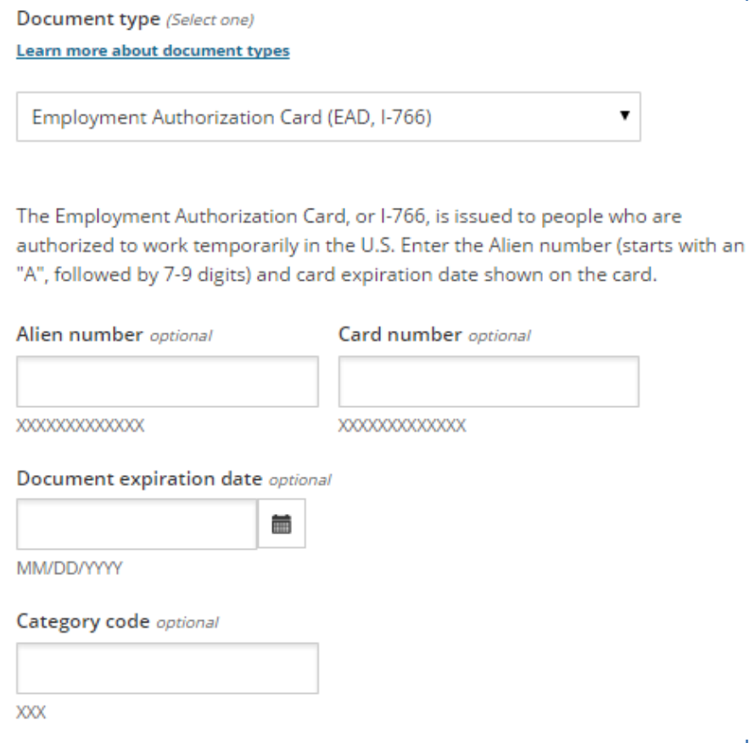
Complete all “Optional” fields
Enter all document numbers that are requested for applicants even if it says they are “optional”
“How To” Guides
Beyond the Basics Reference Guide
Reference Guide to Immigration Documents: Verifying Immigration Status in Healthcare.gov
https://www.healthcare.gov/help/immigration-document-types/
Assister Guide to the Immigration Section of the Online Marketplace Application (and more here: https://marketplace.cms.gov/technical-assistance-resources/special-populations-help )

Slide 40
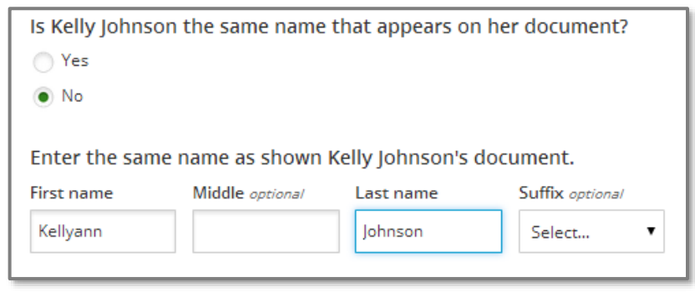
Always note if name on application is not exact match with Immigration document
Name differences or changes: If name on the application is not the same as on the document, use option to provide name as it appears on the document.
Many cultures handle names differently and this can result in differences between application and an immigration document.

Slide 41
In Texas, without a data match the healthcare.gov system can get it wrong!
Texas is one of only 7 states that doesn’t allow most adult green-card holders to get Medicaid, even if they have met the five year bar; and one of 10 states with no Medicaid Expansion.
Without a data match, Healthcare.gov often will send your applicant to Texas Medicaid, causing long delays.

Slide 42
With DMI, Eligibility Outcome Can Be Wrong, Sending applicant to HHSC for Medicaid denial
Why? In most states, lawfully present immigrant adults CAN get Medicaid. Without full correct immigration documents, healthcare.gov may “think:”
Applicants under 138% FPL can get Texas Medicaid; and/or
Based on that incorrect assumption, the applicant is NOT eligible for APTCs because their lack of Medicaid access is NOT related to immigration status.
Marketplace may incorrectly determine an immigrant is in the Coverage Gap. If this happens:
These individuals need to get full correct immigration documentation to Marketplace to show they qualify for tax credits even though their income is below poverty.
Marketplace sometimes incorrectly identifies immigrants as potentially eligible for Medicaid. If this happens:
The consumer has to wait for a eligibility determination (denial) from the Texas Medicaid agency before they can enroll in coverage.
Notes:
Tip sheet also covers issues like not having a SSN and tax filing issues.

Slide 43
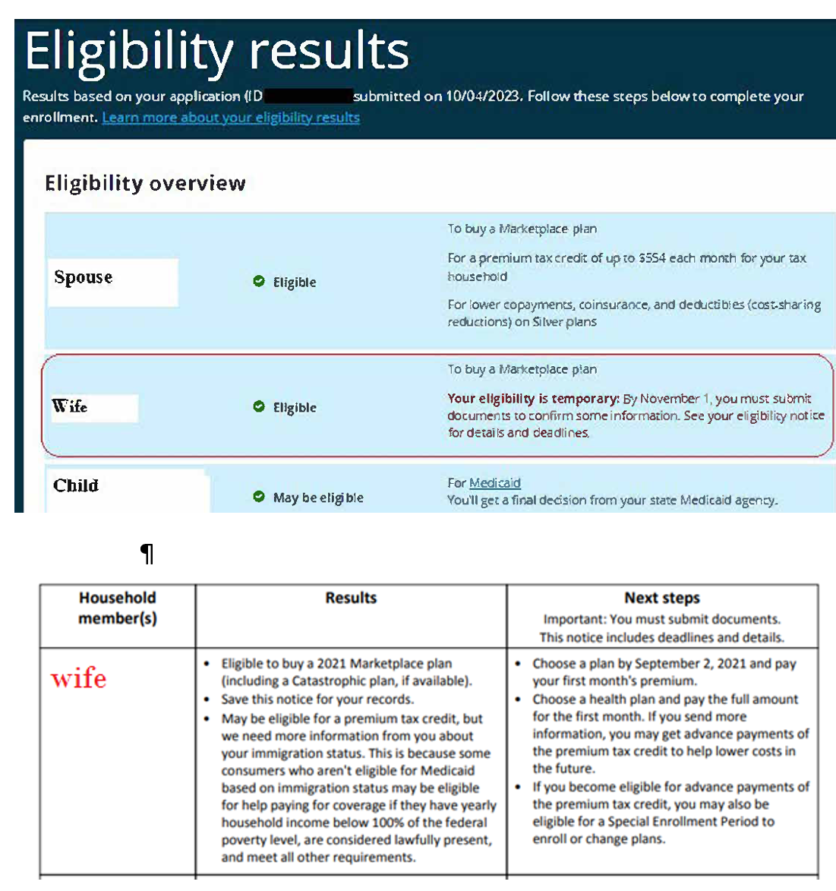
Example: Wife and spouse (left) have been in US for less than a year—wife NOT awarded PTC; husband (only income earner) awarded PTC.
Children sent to Medicaid/CHIP→ accurate! Reminder: if immigrant parents are PTC eligible (as non-immigrant visa holders, at under or above 100%), their children = Medicaid/CHIP eligible (even without social security numbers).
Common Sense Component: If husband eligible under 100%, wife should be too.
Why is this is happening: ANY NUMBER OF REASONS
The Federal HUB is malfunctioning
The USCIS portion of the Federal HUB is down or malfunctioning
The client’s immigration information does not match her identification information
(USCIS or the state may have mixed up her DOB, or her first and last name).
Solution: Send this application to the team’s most experienced Assister, who will indicate on the application that the client would NOT be eligible for Medicaid (even in a state with expanded Medicaid) due to her immigration status.

Slide 44
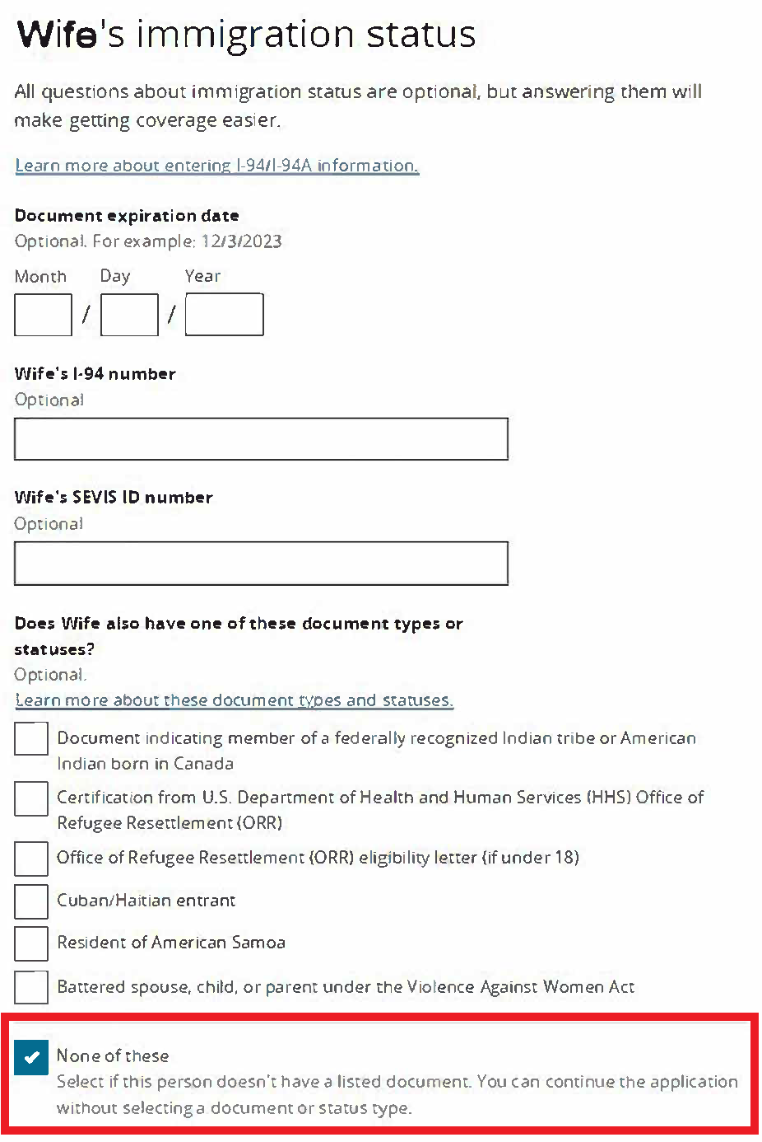
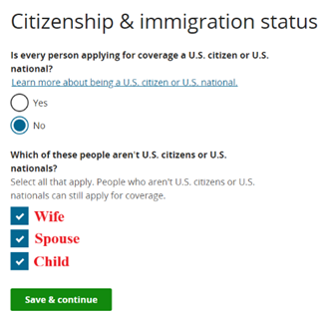
1) Report a Life Change
2) Keep everything the same until you reach the immigration status section for the individual NOT receiving PTC who should be eligible.
3) At the bottom of the individual’s Immigration Status screen (where you would enter the immigration document numbers)—MAKE SURE TO COMPLETE THE LAST SECTION (though it is listed as optional), indicating the individual DOES NOT have any of the listed humanitarian statuses.
Note: you DO NOT need to enter immigration numbers for this work around to work.
Do not skip this optional section for an immigrant eligible for PTC under 100% FPL (since they would be Medicaid-eligible if they had humanitarian status).

Slide 45
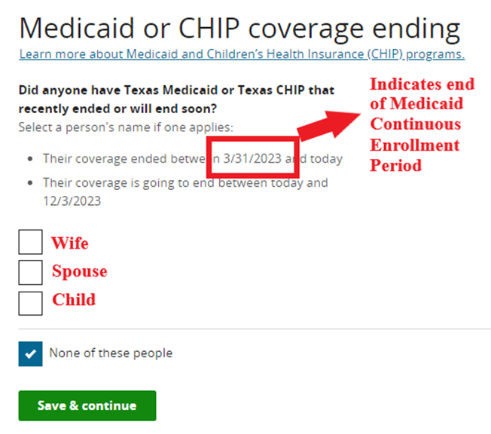
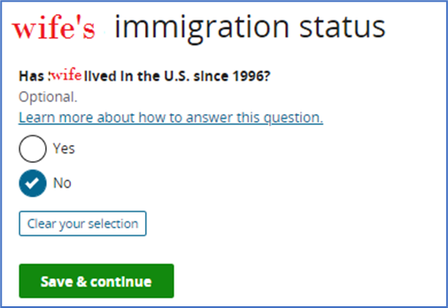
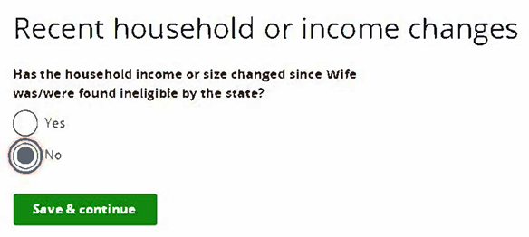
Make sure also to complete this optional screen, which indicates the individual HAS NOT lived in the US since 1996. This screen is another optional one that Lead Assisters should not skip for an immigrant eligible for PTC under 100% (LPRs in the US prior to PWORA’s 1996 passage are not subject to the 5 year bar + 40 quarters and would be Medicaid eligible).
Until July 31, 2024, the MP application will have two sections for Medicaid denial information: one connected to the end of the COVID-19 Continuous Enrollment Period (CEP), and the second connected to a general Medicaid denial.
The example below shows the end of Medicaid due to the CEP, and Assisters can tell by the start date of the end of the CEP.
Note: this section uses the language of Medicaid “Coverage Ending,” not “Denial.”
For the household member who is eligible for APTC under 100%, do not check their indicator box on this screen. Wait for the Medicaid “Denial” indicator box to come
5b) If other household members have Medicaid coverage ending because of the end of the CEP, then you’ll select “No” for this option, as long as the household hasn’t had recent income or tax household structure shifts since that time.

Slide 46
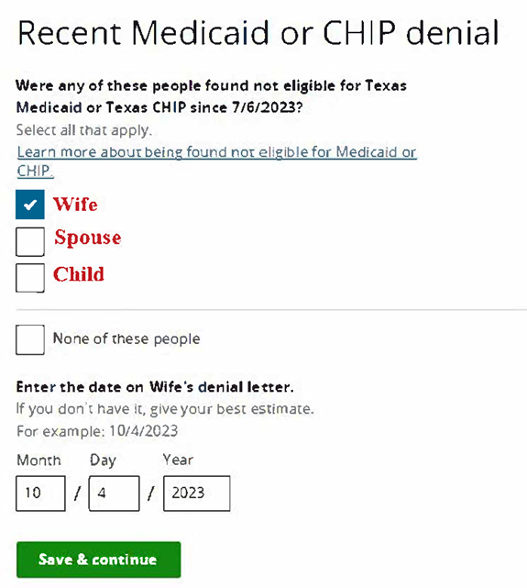
Indicate the individual household member who was originally not deemed eligible for PTC WAS denied Medicaid or CHIP.
This screen will show a date 90 days before the current date, indicating that this screen is not checking for the end of the Medicaid CEP; instead, it’s checking for denial of eligibility for a non-CEP-related reason (like tax filing quarters, age, or medical condition).
Use today’s date as the date of the Medicaid or CHIP denial because you, the expert Assister, determined in good faith the client INELIGIBLE for Medicaid or CHIP based on their immigration status (even if they live in a state that expanded Medicaid).

Slide 47
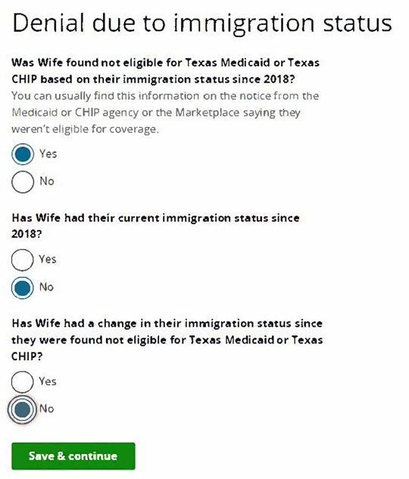
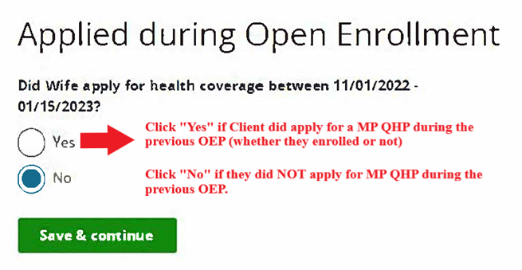
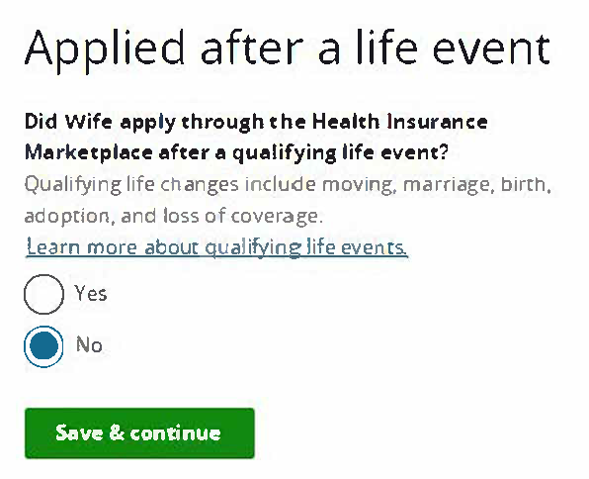
7) Answer these next two questions accurately.
For the individual not awarded PTC, indicate:
That they WERE FOUND INELIGIBLE for Medicaid/CHIP based on immigration status.
That they HAVE NOT had their current immigration status since 2016.
That their immigration status HAS NOT CHANGED since their Medicaid/CHIP denial (today).

Slide 48
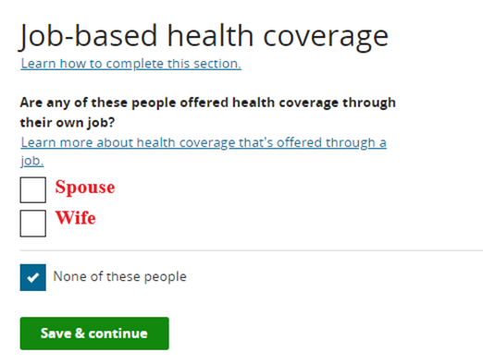
No further application changes should be necessary—the application and eligibility letter should grant APTCs to the impacted individual once the Lead Assister resubmits the application.
If the work-around is working…
The individual who was inaccurately deemed PTC-ineligible previously SHOULD BE LISTED in the following section. This listing demonstrates that the application is still determining their PTC eligibility.
If that individual is NOT listed in the Job-based coverage section, the application is no longer assessing them for PTC, so the application is still either deeming them ineligible for PTC under 100%, and/or is deeming them eligible for Medicaid/CHIP.
If the individual the individual you are seeking PTC for is NOT listed in this section now, scroll back through the earlier screens because you may have missed something.

Slide 49
Some Immigrants Enroll and Then Lose Coverage Due to Data Inconsistencies
When electronic data cannot confirm the income and/or citizenship or immigration status of a person, they can still enroll in coverage but they must provide uploaded documentation within 90 days.
This process has improved in more recent years compared to the beginning. Between 2015 and 2016 there was an 85 percent decrease in DMI’s for immigration status issues and a 69 percent decrease in households with DMI’s for income.
No data has been released by CMS on DMIs since 2016.
Go deeper: Health Reform Beyond the Basics Webinar: Preventing and Resolving Data-Matching Issues
Notes:
The fact there is an inconsistency does not mean the consumer is not eligible; it just means additional checking has to take place to confirm eligibility and the amount of assistance the consumer should receive.
Open guide and show them the Addendums.

Slide 50
Resources
Health Reform Beyond the Basics
Reference Guide to Immigration Documents: Verifying Immigration Status in Healthcare.gov
Webinar recordings
Every Texan
Immigrants' Access to Health Care in Texas: An Updated Landscape
Right to Public Benefits for Immigrant Populations Served by the U.S. Office of Refugee Resettlement (ORR)
CMS
Assister Guide to the Immigration Section of the Online Marketplace Application
https://www.healthcare.gov/help/immigration-document-types/
Georgetown Center for Children and Families
Getting Enrollment Right for Immigrant Families

Slide 51
What is Public Charge and who does it apply to?
Notes:
ESTHER El objetivo de esta presentación es compartir información concreta sobre la carga pública con la comunidad inmigrante para que puedan tomar decisiones informadas y recibir los beneficios públicos que les corresponden. Hablaremos de qué es la carga pública y a quién aplica. Además, hablaremos sobre los beneficios que cuentan y no cuentan en una prueba de carga pública. En general, esperamos que esta presentación lo anime a usted y otros miembros de la comunidad inmigrante a acceder los servicios de apoyo necesarios sin temor.
Diríjase con confianza,

Slide 52
Does this mean if my kids seek medical attention I can be deported?
I think this means I should disenroll from benefits.
Does this mean if I apply for benefits I can’t become a citizen?
I think this means my family can’t apply for any help.
Notes:
ESTHER Hay muchos mitos sobre la carga pública que se desarrollaron durante los últimos años. Esto se debe a que el ex presidente Trump dijo muchas cosas odiosas y falsas sobre los inmigrantes
para los inmigrantes, la carga pública es a menudo un tema cargado y confuso, especialmente después de Trump, y hablar de
ello puede generar varios temores, preocupaciones y emociones. Después de hoy, esperamos que tenga una mejor idea de los detalles de la ley para que pueda inscribirse en programas de apoyo que ayudarán a su familia a prosperar, sin temor a las consecuencias negativas de la inmigración.

Slide 53
public charge policy
A test/assessment on US immigration law that applies to two types of cases:
Applying for a visa to enter the US
Applying for permanent residence through a relative
The “public charge test” assesses whether someone is likely to be dependent on public benefit programs in the future.
Most people don't need to worry about public charge.
Notes:
KARLA La buena noticia es que la carga pública es una parte mucho más pequeña de la ley de inmigración de lo que la mayoría de la gente piensa.
La carga pública es una prueba en la ley de inmigración que solo se aplica a dos tipos de casos: si está solicitando una visa para ingresar a los Estados Unidos, y si está solicitando la residencia permanente, que también se llama “tarjeta verde,” a través de un ciudadano estadounidense o un familiar residente permanente.
La prueba evalúa si un solicitante de uno de estos dos tipos de beneficios de inmigración parece depender de los beneficios públicos en el futuro. Si los funcionarios de inmigración deciden que es probable que el solicitante dependa de los beneficios públicos en el futuro, pueden denegar la tarjeta de residencia o la solicitud de visa de la persona.

Slide 54
MOST GOVERNMENT PROGRAMS DO NOT Count As a Public Charge
Only 2 types are considered:
Financial assistance in cash/check.
SSI check
Temporary Assistance for Needy Families (TANF)
Some state and local cash assistance programs
Long-term institutional health care paid for by the government, for example in a nursing home.
Immigration officials cannot consider any government programs used by other members of your family or household.
Notes:
KARLA La mayoría de los programas gubernamentales no afectan la carga pública. Solo hay 2 tipos de programas que son considerados:
Asistencia económica mensual en efectivo
Atención médica institucional prolongada pagada por el gobierno

Slide 55
Public Benefits Not Considered
Health Care:
Medicaid (except for long term institutionalization), CHIP, Marketplace subsidies, Medicare, immunizations, or
testing/treatment for
communicable diseases
Food:
Nutrition programs, such as Supplemental Nutrition Assistance Program (SNAP), Special Supplemental Nutrition Program for Women, Infants, and Children (WIC), school lunch programs, and food banks.
State Programs:
Other state-based, non-cash assistance programs
Housing:
Subsidized housing programs,such as Section 8 and Public Housing
COVID:
COVID vaccines, testing, and
treatment, and COVID-related supports, such as Pandemic Electronic Benefits Transfer (P-EBT),stimulus payments, child tax credits,and emergency rental assistance
CASH BENEFITS:
Cash benefits based on work or earnings, including Social Security,retirement, pensions, veterans benefits
Notes:
KARLA
No se considera ningún otro programa en la carga pública.

Slide 56
Key Points
The Public Charge test only applies to some benefits and some immigration statuses.
COVID-19 tests, treatment, or vaccines do not count as public charge.
Using public benefits alone does not make someone a public charge.
Use of health, food, or housing programs do not count in a public charge test.
A family members’ use of public benefits does not count in your own immigration application.
Notes:
ESTHER

Slide 57
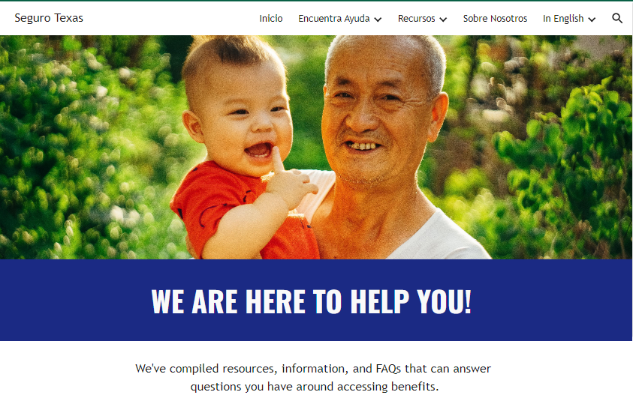
For families
For advocates
For enrollment assisters
¿Quieren mantenerse actualizados? ¡Apúntense aquí!
Want to stay updated? Sign up here!

Slide 58
The truth about Public Charge
https://segurotexas.org/en/
Karla Martinez
kmartinez@everytexan.org

Slide 59
Immigrant families can seek basic answers from Free or Low-Cost Immigration Legal Services groups
Not possible for most community-based organizations, health/hunger/housing providers to try to be immigration experts! Things we CAN tell families to help them:
Not necessary to engage a private attorney immediately. Important questions whether use of public benefits by your family will affect you at all-- can be answered free or very low cost by non-profit immigration legal services organizations.
Houston Immigration Legal Services Collaborative
Hotline: 1-833-468 4664
Website: https://www.houstonimmigration.org/hotline/
Notes:
ANNE

Slide 60
Texas State of Enrollment 2023
For People and Organizations who help Texans enroll in Medicaid, CHIP, the Health Insurance Marketplace, Healthy Texas Women, SNAP, WIC, and TANF:
Federal ACA Navigators,
ACA Certified Application Counselors,
Texas HHS Community Partner Program Navigators, and
Health insurance agents who specialize in Marketplace enrollment.
Food Bank staff
All sessions are virtual and free to attend.
Sessions will be from 10:30 AM to 12:00 PM and 1:30 PM to 3:00 PM Central each day Oct. 10, 11 and 12.
Every Texan is proud to co-host this annual conference with the Texas Association of Community Health Centers and Young Invincibles.
Recording of all sessions will be posted at Every Texan after the conference.
Register for TSOE 2023!

Slide 61
Support for Immigrant Benefits Eligibility/Public Charge briefings:
Every Texan, https://everytexan.org/ @EveryTxn
Children's Defense Fund–Texas, cdftexas.org; @CDFTexas
EVERY TEXAN; ANNE DUNKELBERG, dunkelberg@everytexan.org; 512-627-5528
EVERY TEXAN; KARLA MARTINEZ, Policy Analyst; martinez@everytexan.org
CHILDREN'S DEFENSE FUND–TEXAS; ESTHER REYES ereyes@childrensdefense.org , 512-568-7912
Get Seguro Texas Public Charge Updates: English- Sign up here! Spanish- ¡Apúntense aquí!
Join the national Protecting Immigrant Families Campaign
https://protectingimmigrantfamilies.org/

